Slide 1


Workshop: Response Bias in Self-Report Measurements Why controlling for acquiescence matters?
Dr. Ricardo Primi
Universidade São Francisco (USF) and Ayrton Senna Institute Edulab21 (IAS)
Dr. Felipe Valentini
Universidade São Francisco (USF)
ITC Granada, Spain, July, 2024

Slide 2
Validity
Self-reports are multidimensional
Suppression and inflation
Internal consistency
Developmental psychometrics
Criterion validity
Cross cultural comparability: Aptitude achievement paradox

Slide 3
3-variables interactions: role of suppression and inflation

Slide 4
Notes:
Scasles with only true keyed items

Slide 8
How acquiescence influences internal consistency?

Slide 9
Effects of acquiescence in internal structure
Tends to increase correlations of items with same type ++ / --
Tends to decrease correlations of items with different types + -
Consequently: bias internal structure (factors based on type of item)
Since alfa is a function on inter-item correlations
bias reliability upwards or downwards depending on the number of + and – and their true correlations

Slide 10
Example 1: SENNA internal structural analysis
https://www.frontiersin.org/journals/psychology/articles/10.3389/fpsyg.2021.716639/full

Slide 13
Original
Acquiescence controlled

Slide 14
Example 2: OECD’s Survey on Social and Emotional
Data from first round field trial analysis of original responses and controlled by acquiescence
https://www.oecd.org/education/ceri/social-emotional-skills-study/

Slide 15
Effects on inter-item correlations on OECD items

Slide 16
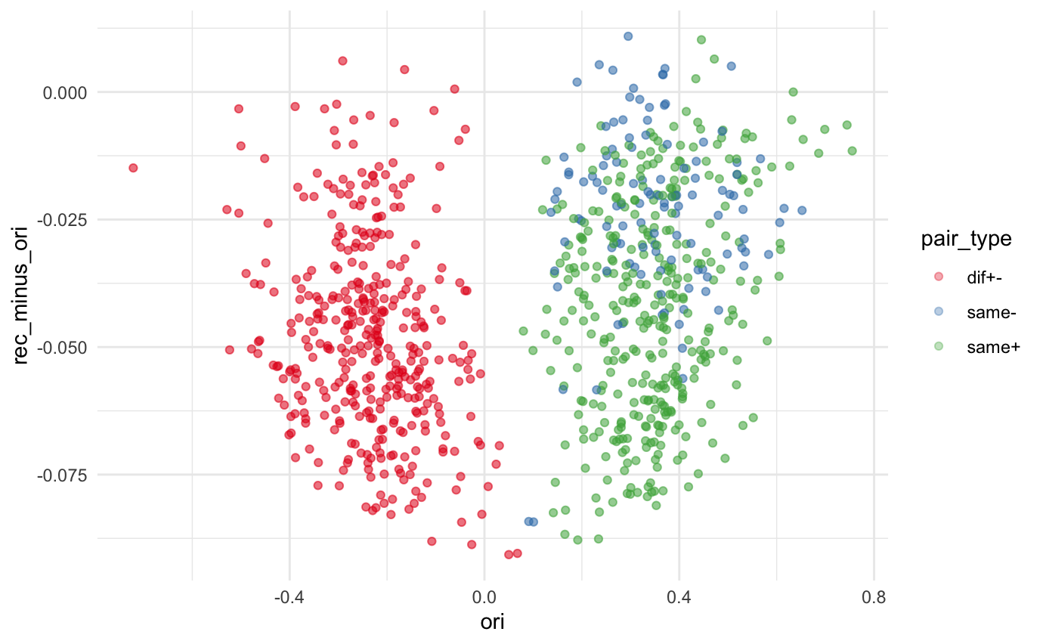

Slide 17
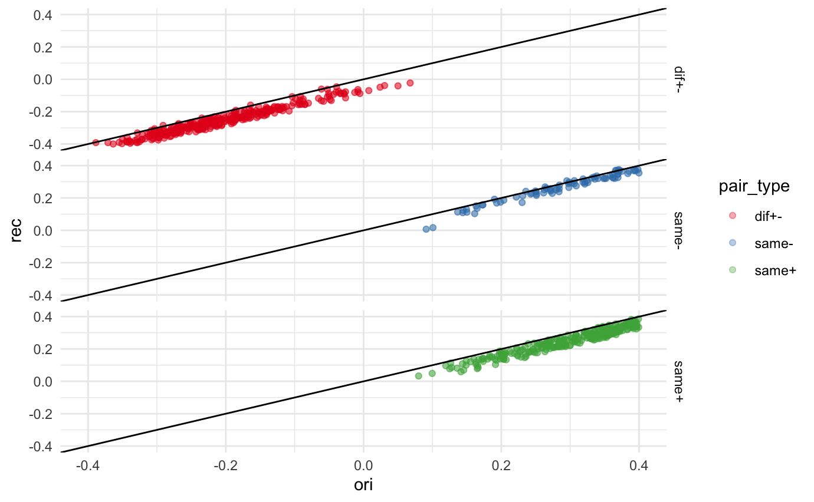

Slide 18
Effects on reliability of scales

Slide 20
Effects on factor structure (factor congruency)

Slide 21
Developmental Psychometrics

Slide 24
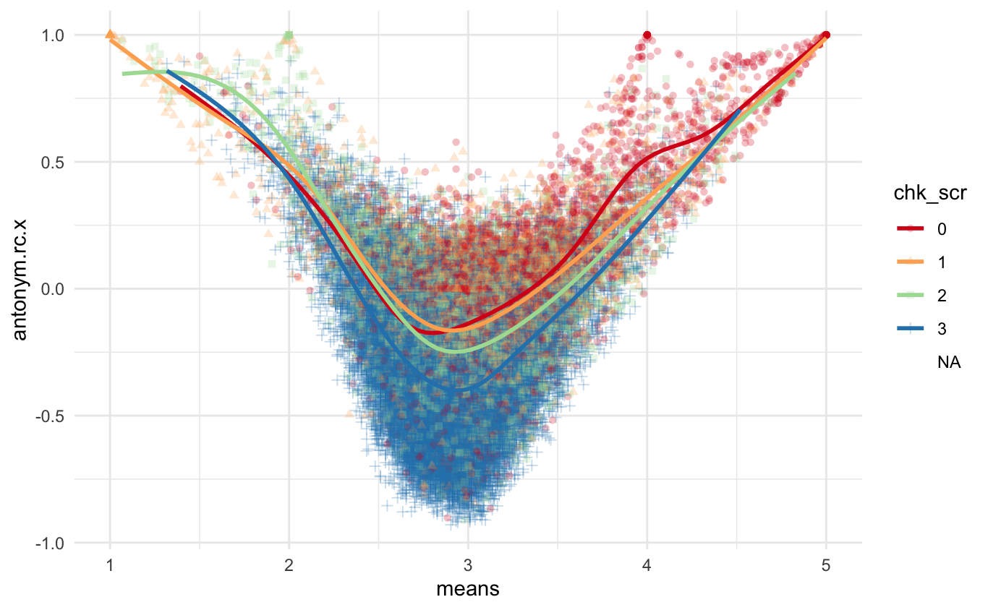

Slide 25
How much acquiescence would be a problem for OECD study?

Slide 26
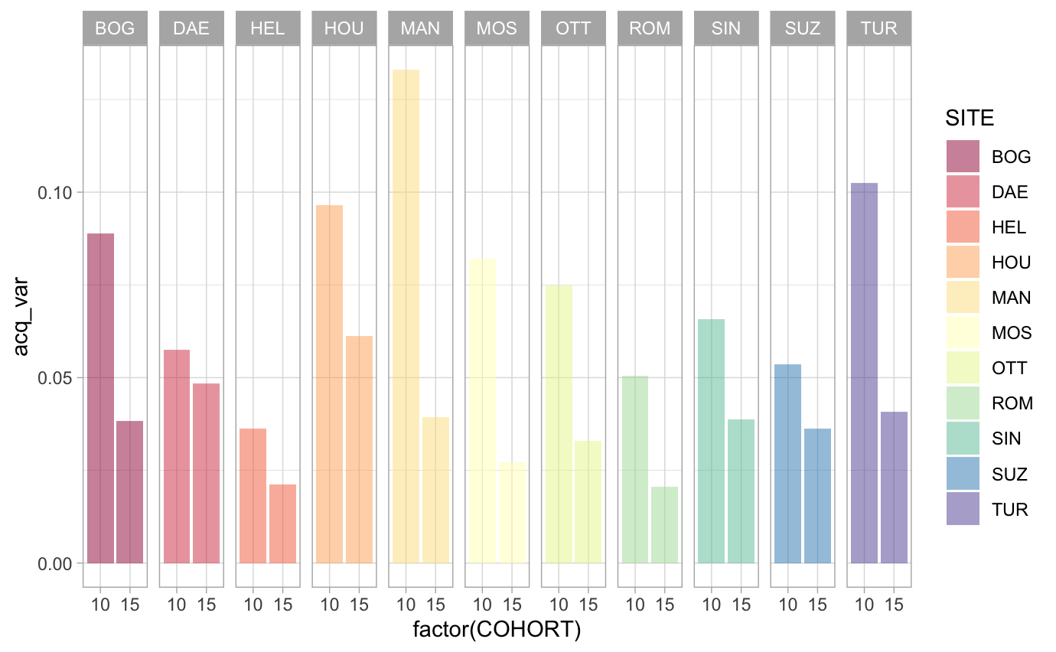

Slide 27
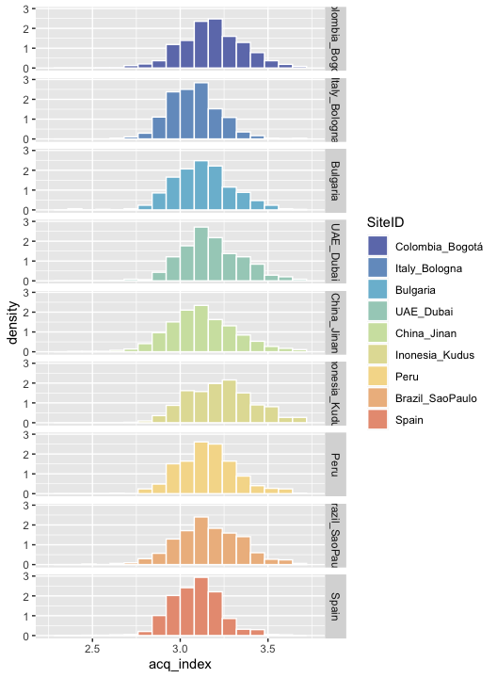

Slide 28
Criterion validity

Slide 29
Cronbach's prophecy

Slide 31
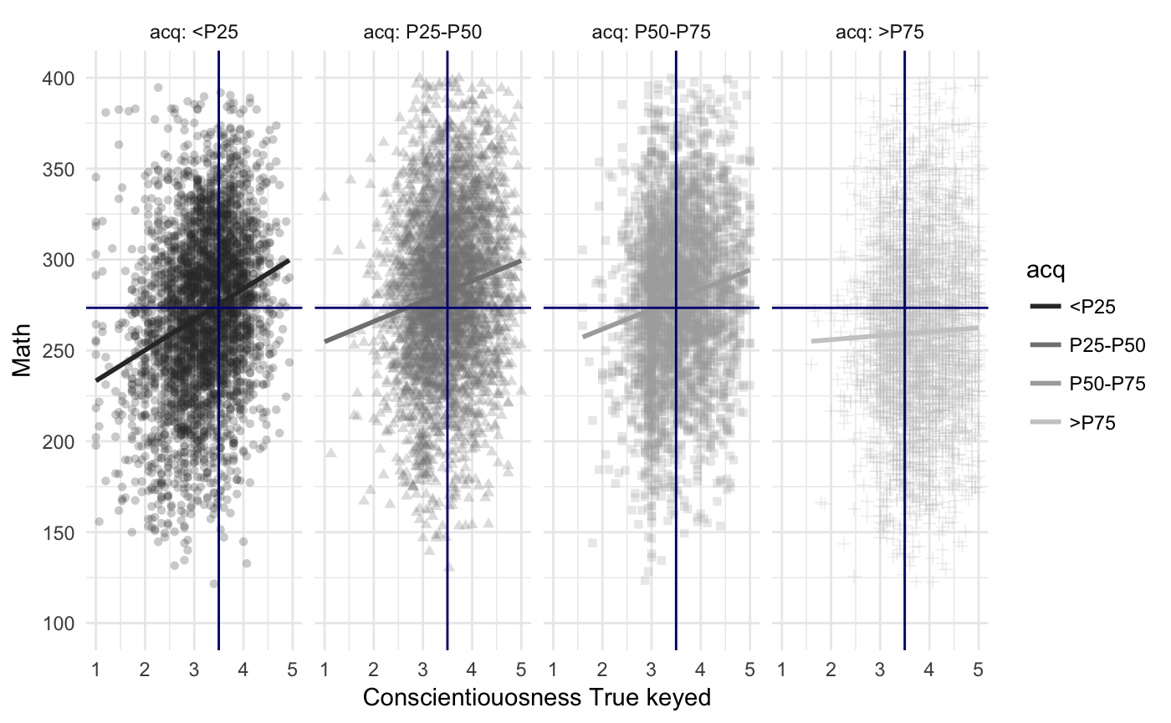
“since response tendencies affect an answer only when the student is to some degree uncertain about the content of the item, acquiescence tends to make false items, more valid, and true items less valid … The poor student, guessing, tends to be right on the true item because of acquiescence, but tends to be wrong on the false item.” (Cronbach, 1946 p. 480)

Slide 32
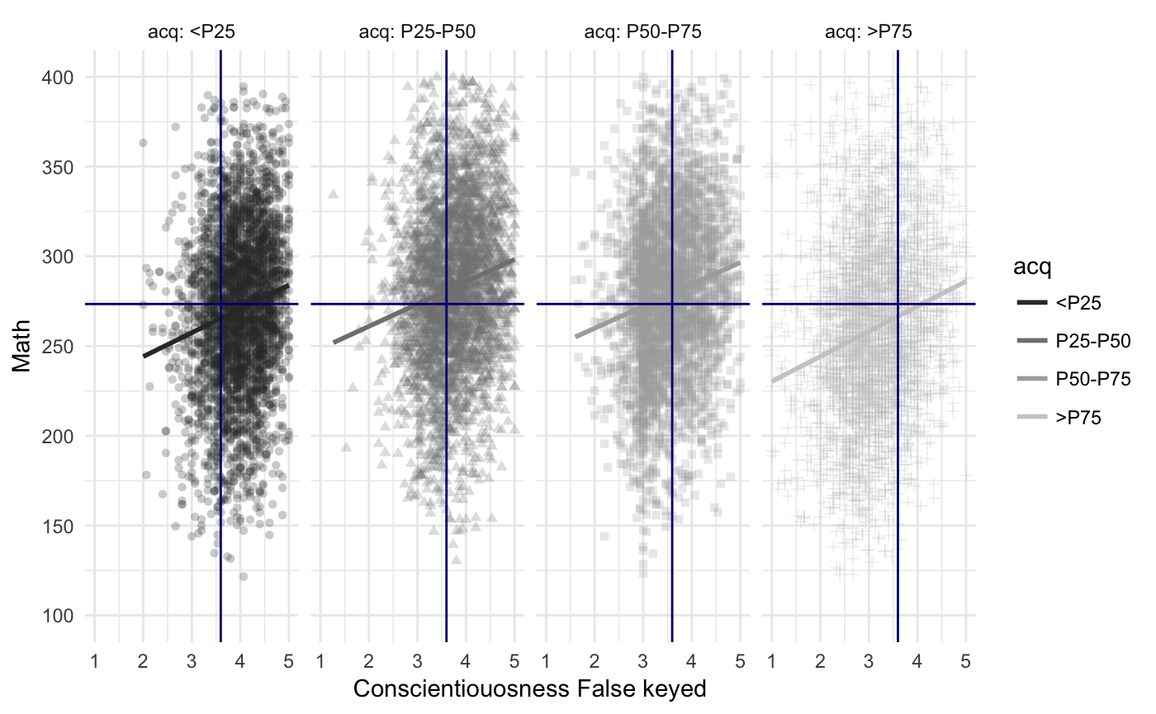
Notes:
Note: all items were reversed before calculating the score

Slide 33
Pisa 2012 data

Slide 35
Effects of acquiescence in criterion validity: PISA 2012
Perseverance with Math

Slide 36
Effects of acquiescence in criterion validity: PISA 2012
Perseverance with Math

Slide 39
Cross cultural comparability: Aptitude achievement paradox

Slide 40
Programme for International Student Assessment (PISA)
Assessing social and emotional skills as outcomes
PISA has been an important system for providing benchmarks for international comparisons and monitoring trends over time.
Cognitive tests measure the ability to apply knowledge to solve practical problems (language, math science, and an innovative domain).
Self-report questionnaires assess additional constructs such as social-emotional skills (Bertling & Alegre, 2018).
explanatory factors of learning outcomes
outcomes of 21st century education

Slide 41
Examining aptitude achievement paradox in PISA
The challenge with PISA self-assessment is how to achieve cross-culturally comparable measures.
How can we compare different cultures in self reported perseverance for instance?
Aptitude-achievement paradox (Kyllonen & Bertling, 2013).
There have been many attempts to solve this problem (like anchoring vignettes), but none have been completely successful
One of the techniques, we used in SENNA to control acquiescence and assist with resolving part of this issue.
Primi, R; Bertling, J., Kyllonen, P., Hauck-Filho, N., & Valentini, F. (2019) Acquiescence and attitude-achievement paradox in PISA 2012. Paper presented at 84th Annual Meeting of the Psychometric Society, Santiago, Chile.

Slide 42
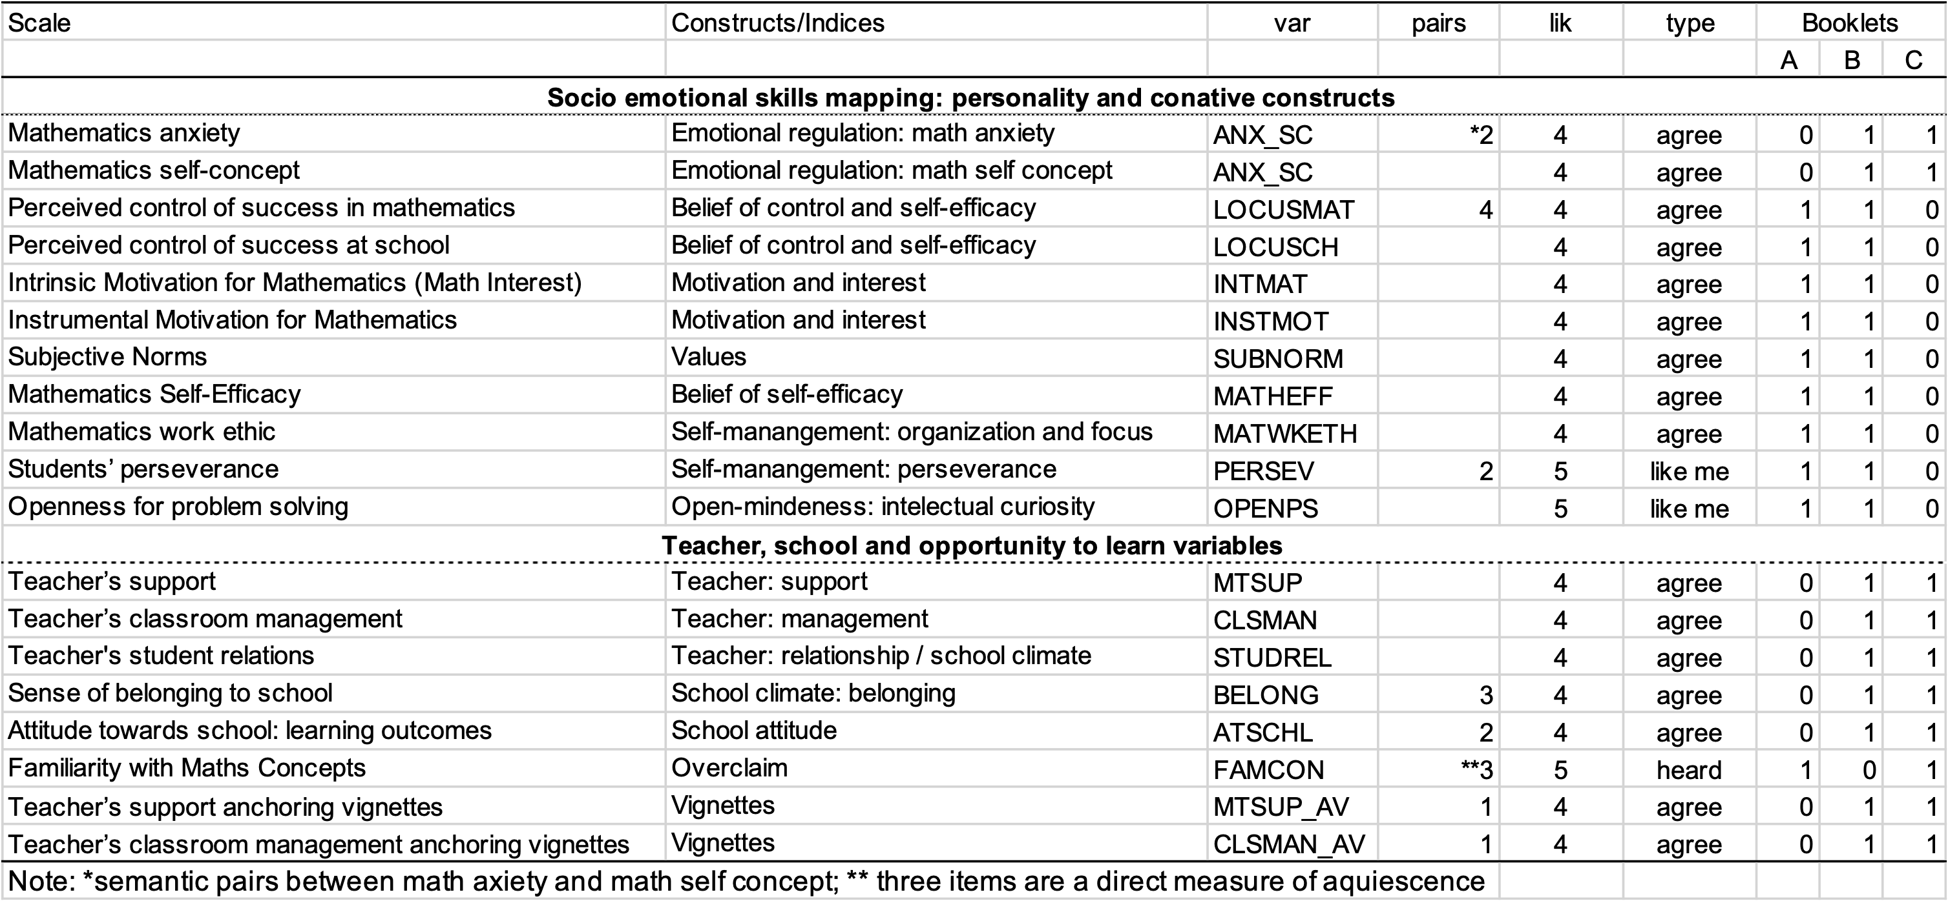
PISA 2012
Reanalysis of data on social and emotional characteristics
480,174 students from 66 countries and economies
17 scales
Inconsistent index based on 18 pairs of items
We proposed a method for rescaling responses and rescoring that controls for inconsistent responses
Primi, R; Bertling, J., Kyllonen, P., Hauck-Filho, N., & Valentini, F. (2019) Acquiescence and attitude-achievement paradox in PISA 2012. Paper presented at 84th Annual Meeting of the Psychometric Society, Santiago, Chile.

Slide 43
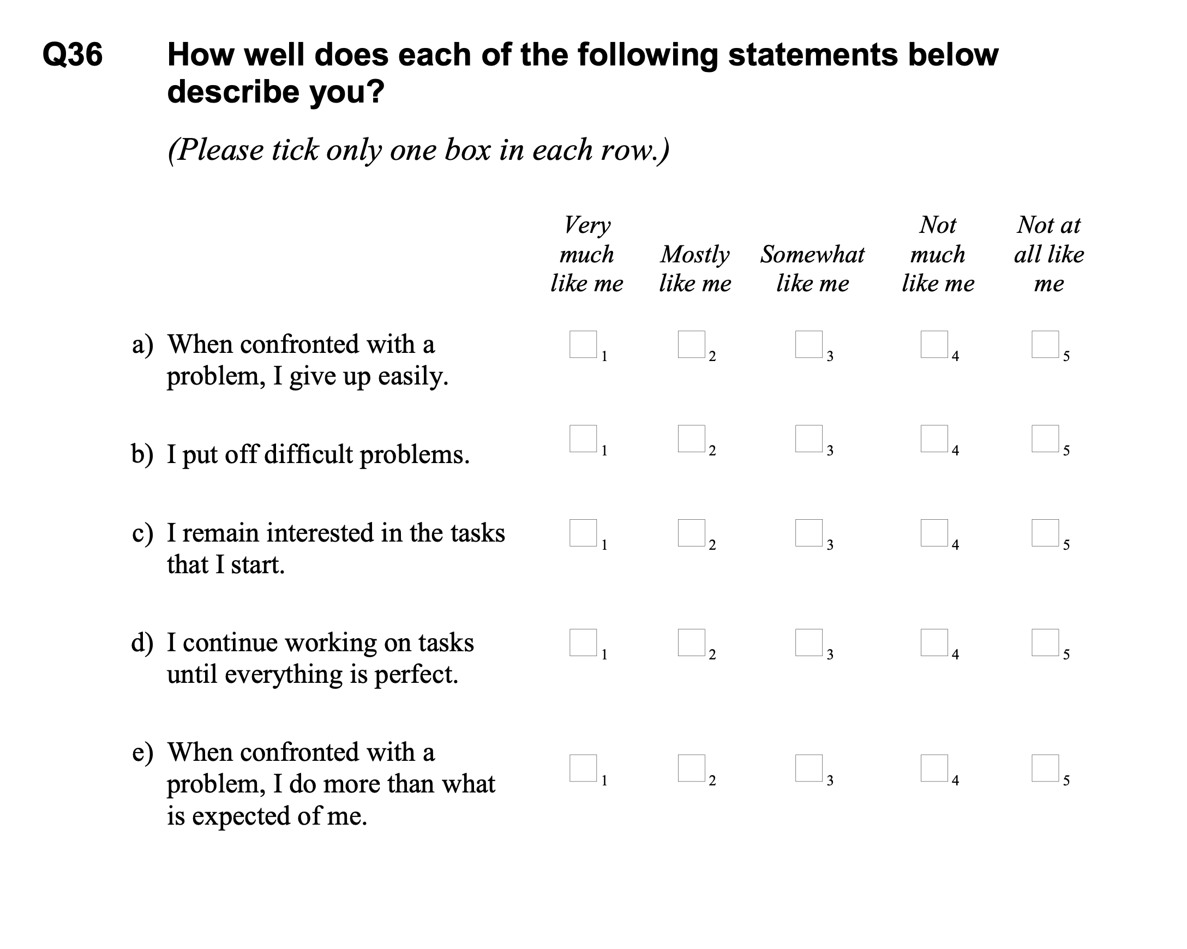
Perseverance scale PISA 2012
Notes:
Lets focus in perseverance

Slide 44
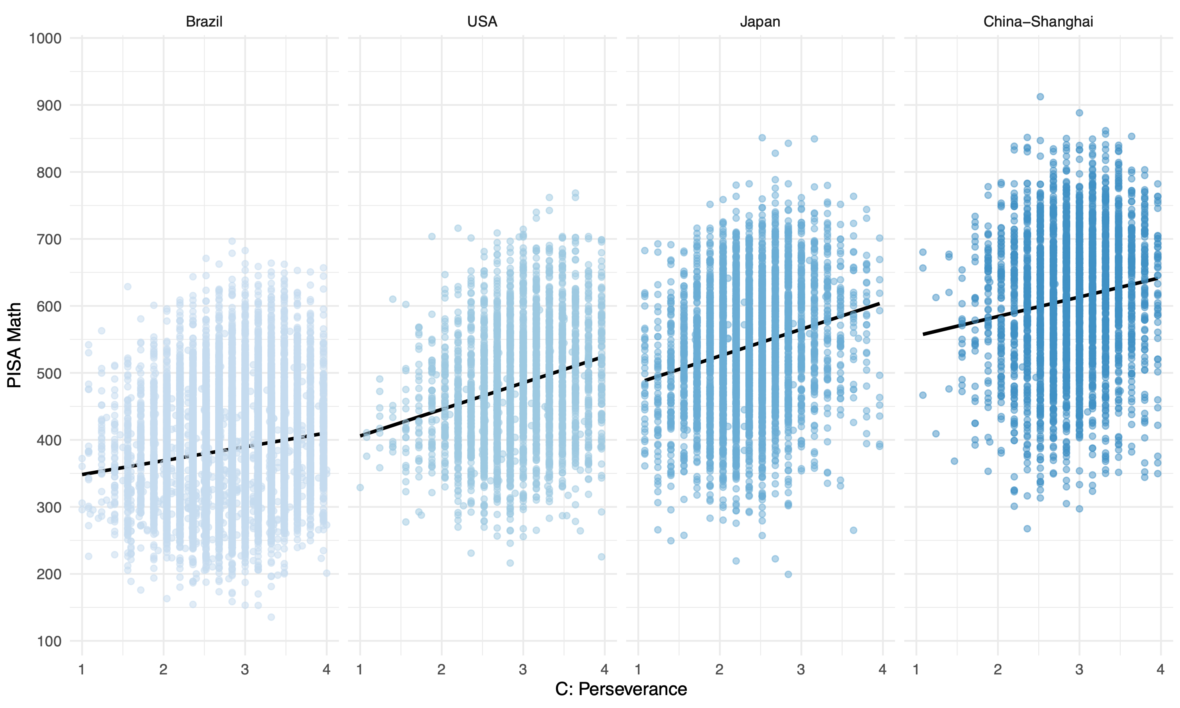
Aptitude achievement paradox
r = .21
r = .26
r = .17
r = .10
Notes:
What is aptitude achievement paradox?

Slide 45
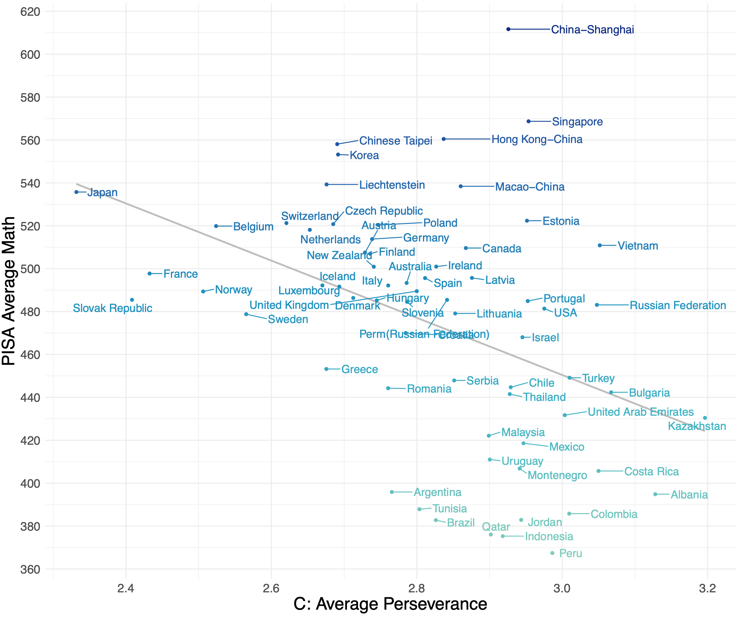
Aptitude achievement paradox
r = -.42
Example of a Simpson’s paradox when we encounter data where “an association that is observed on entire population reverses in every subpopulation” (Pearl et al., 2016, p. 3)
Notes:
We cannot use a relationship in one level (country) to make inferences about the relationship in another level (individuals)- ecological fallacy. Associations at the aggregate level say something about the macro-level unities (country) that is different from associations seen at micro-level students unities. But although we have plausible explanations for the positive association at the individual-level data, little is known about what a negative correlation at the country level would mean about countries

Slide 46
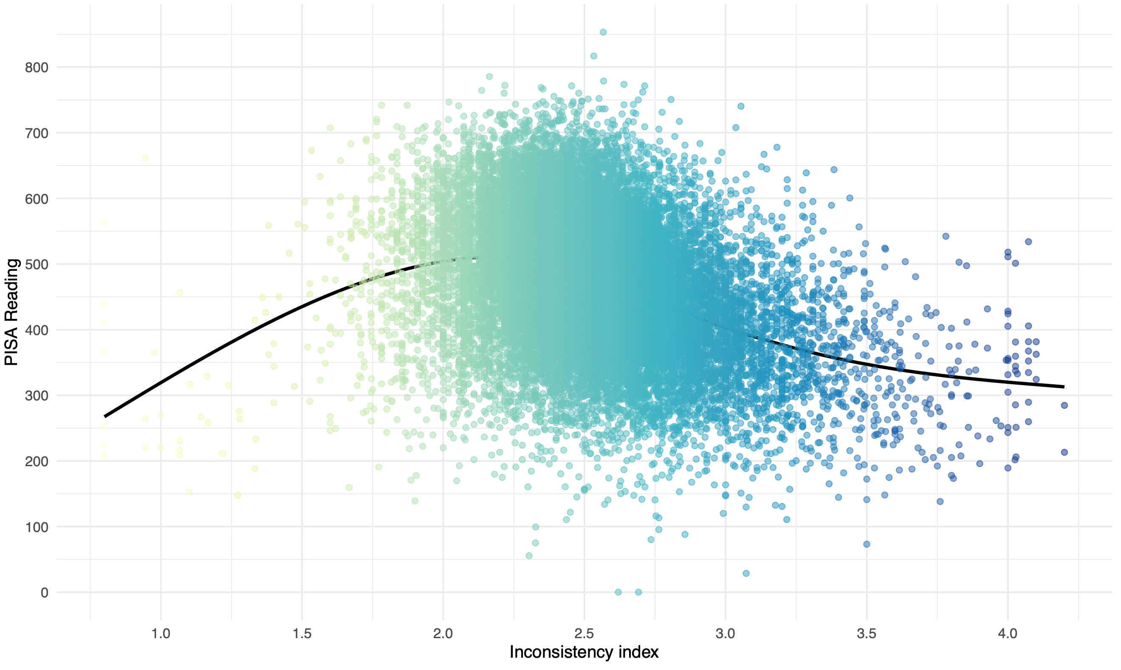
Inconsistency vs achievement
Inconsistency -> low achievement
r = -.32
Notes:
Sure enough

Slide 47
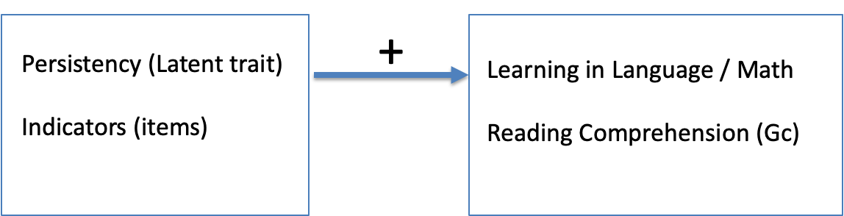
Understanding the problem

Slide 48
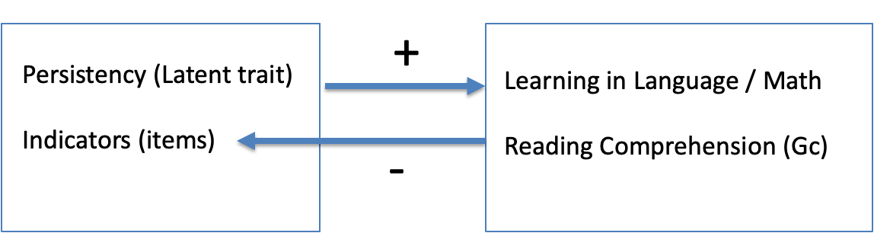
Understanding the problem

Slide 49
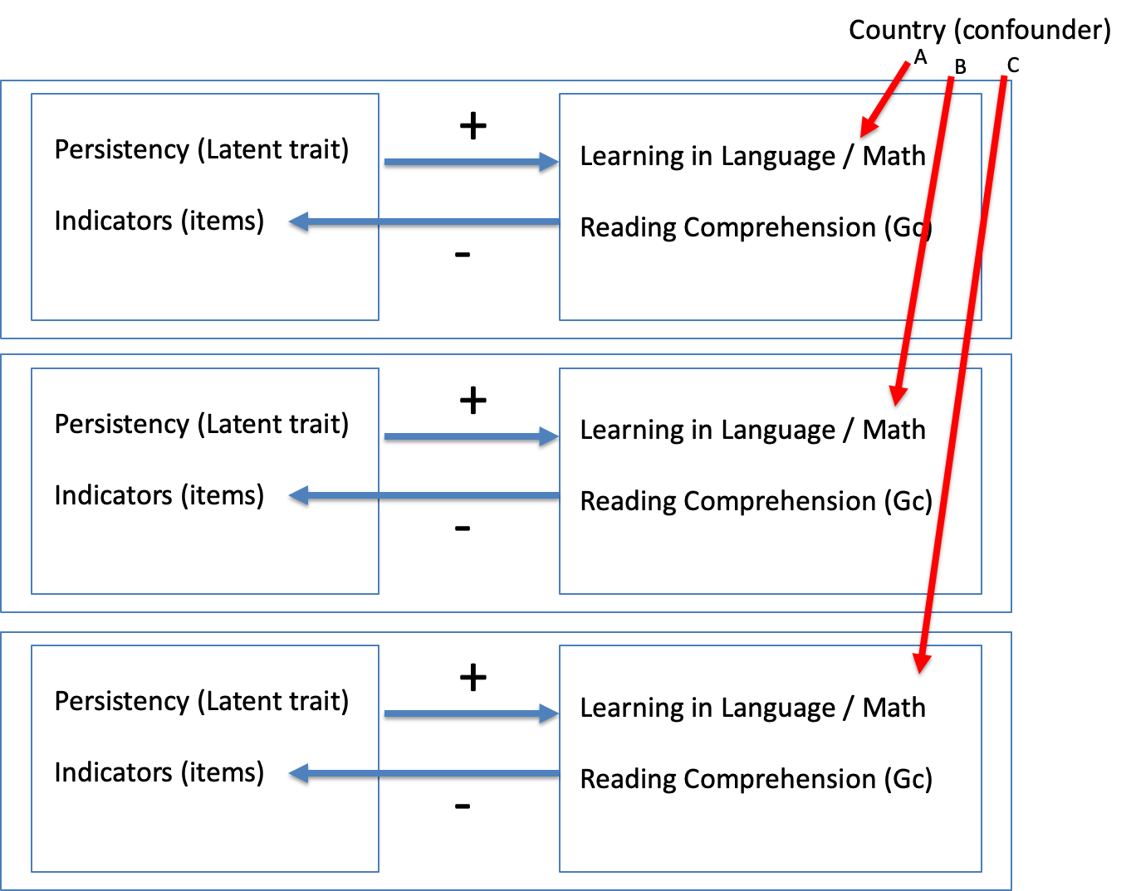
Understanding the problem

Slide 50
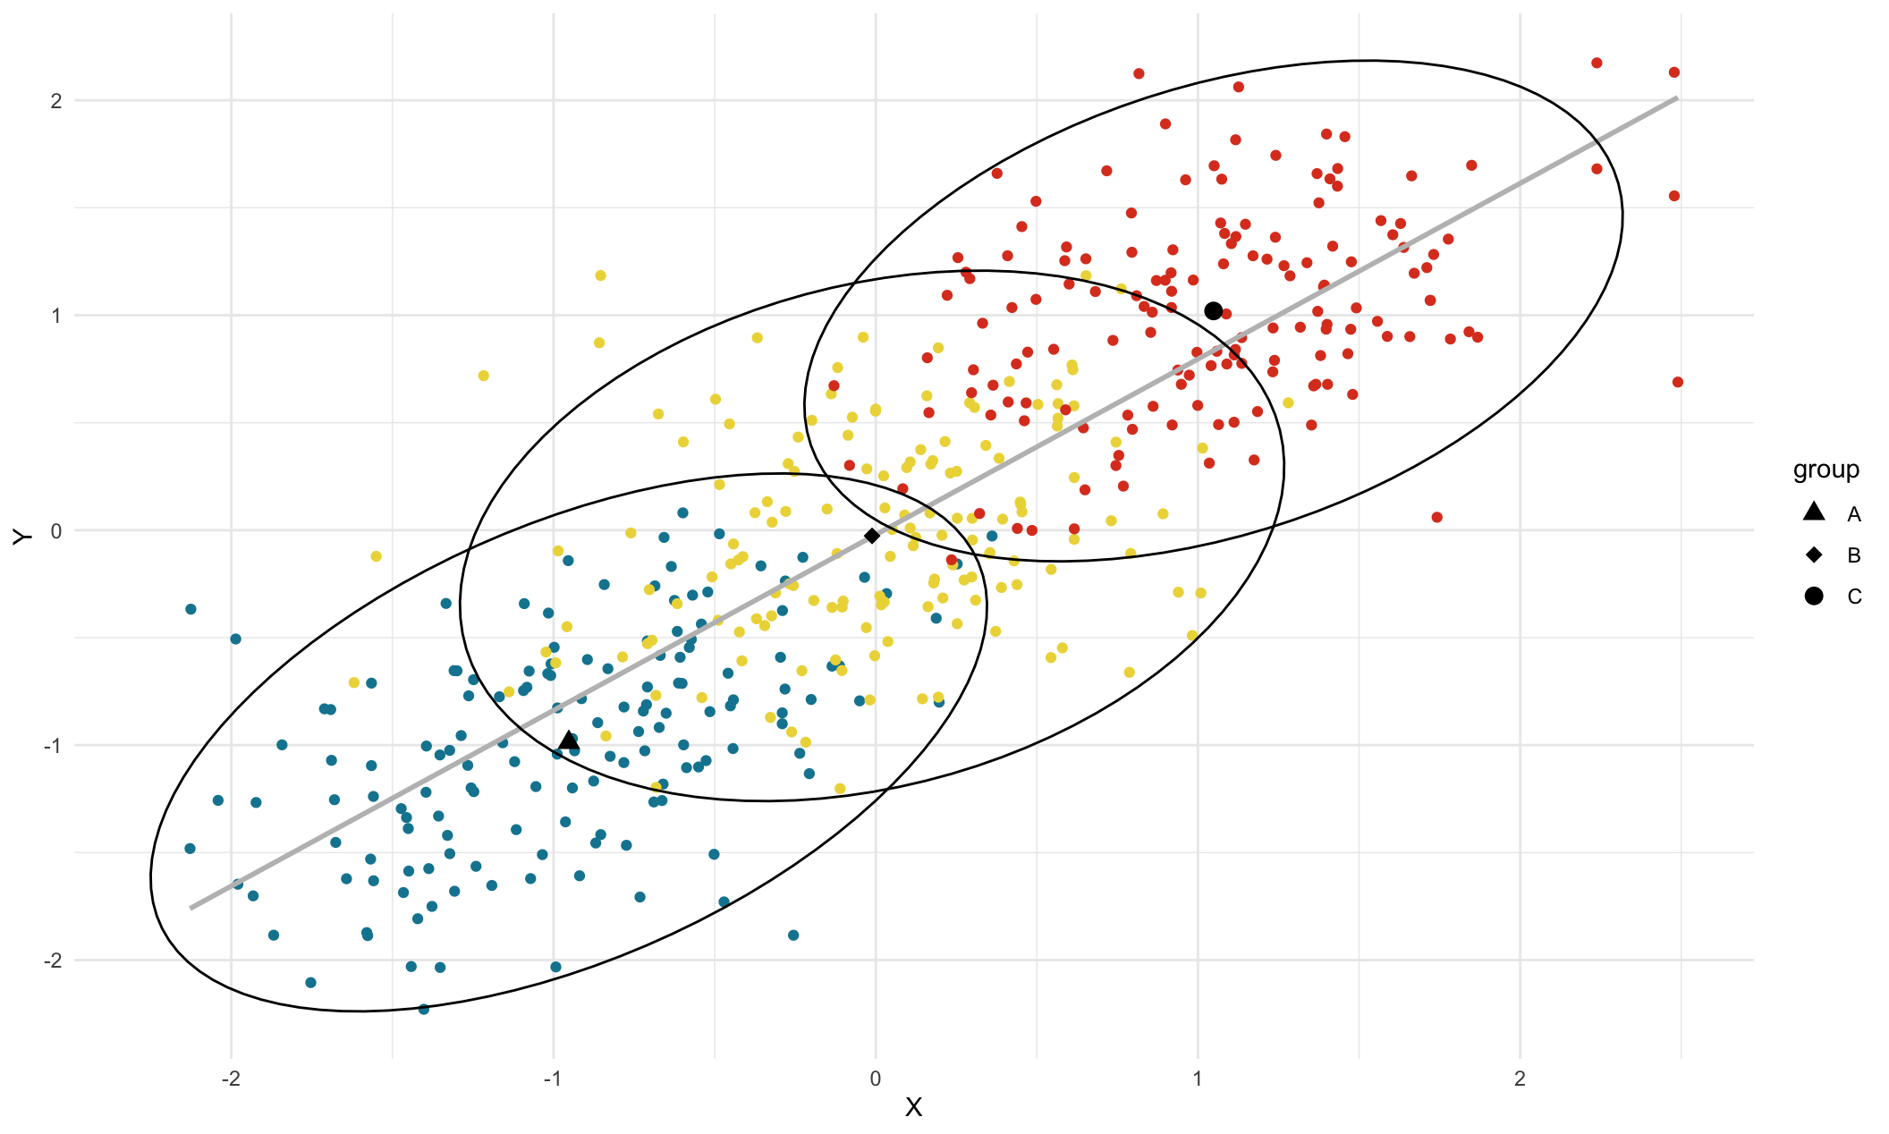

Slide 51
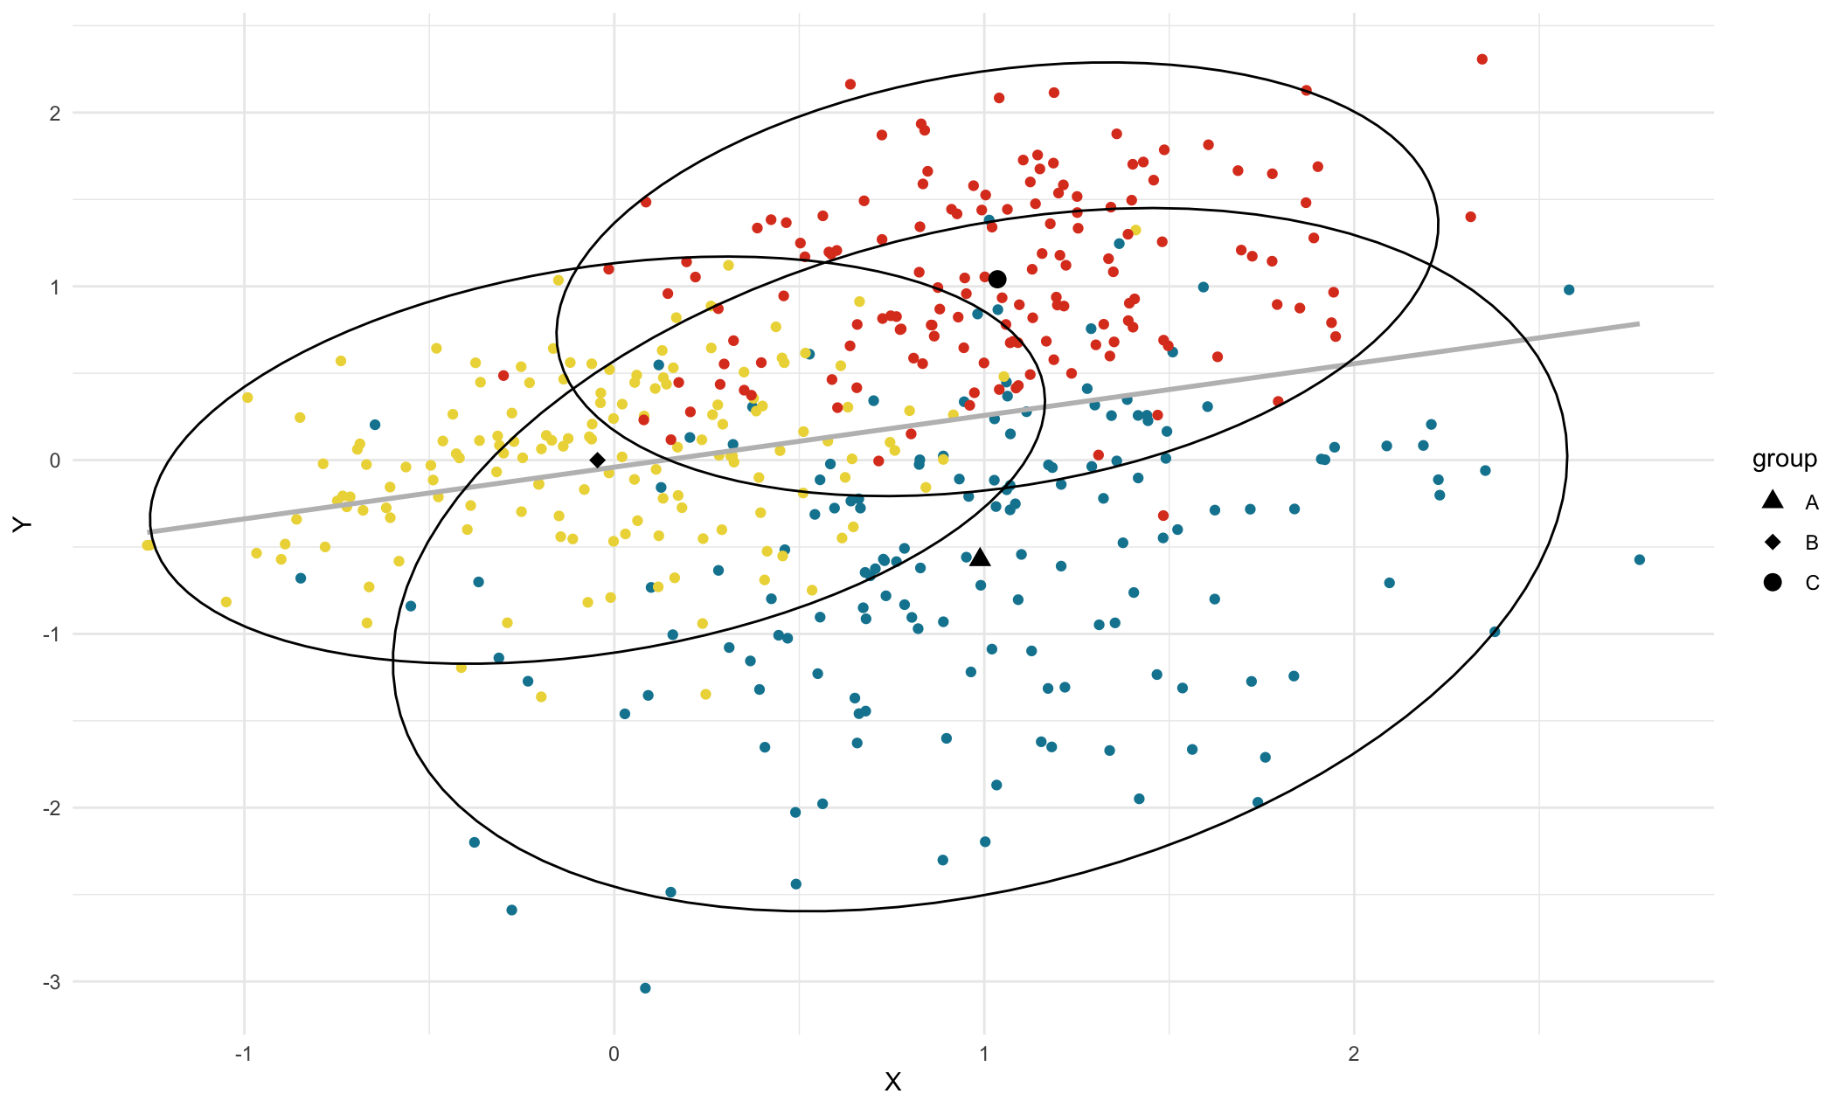

Slide 52
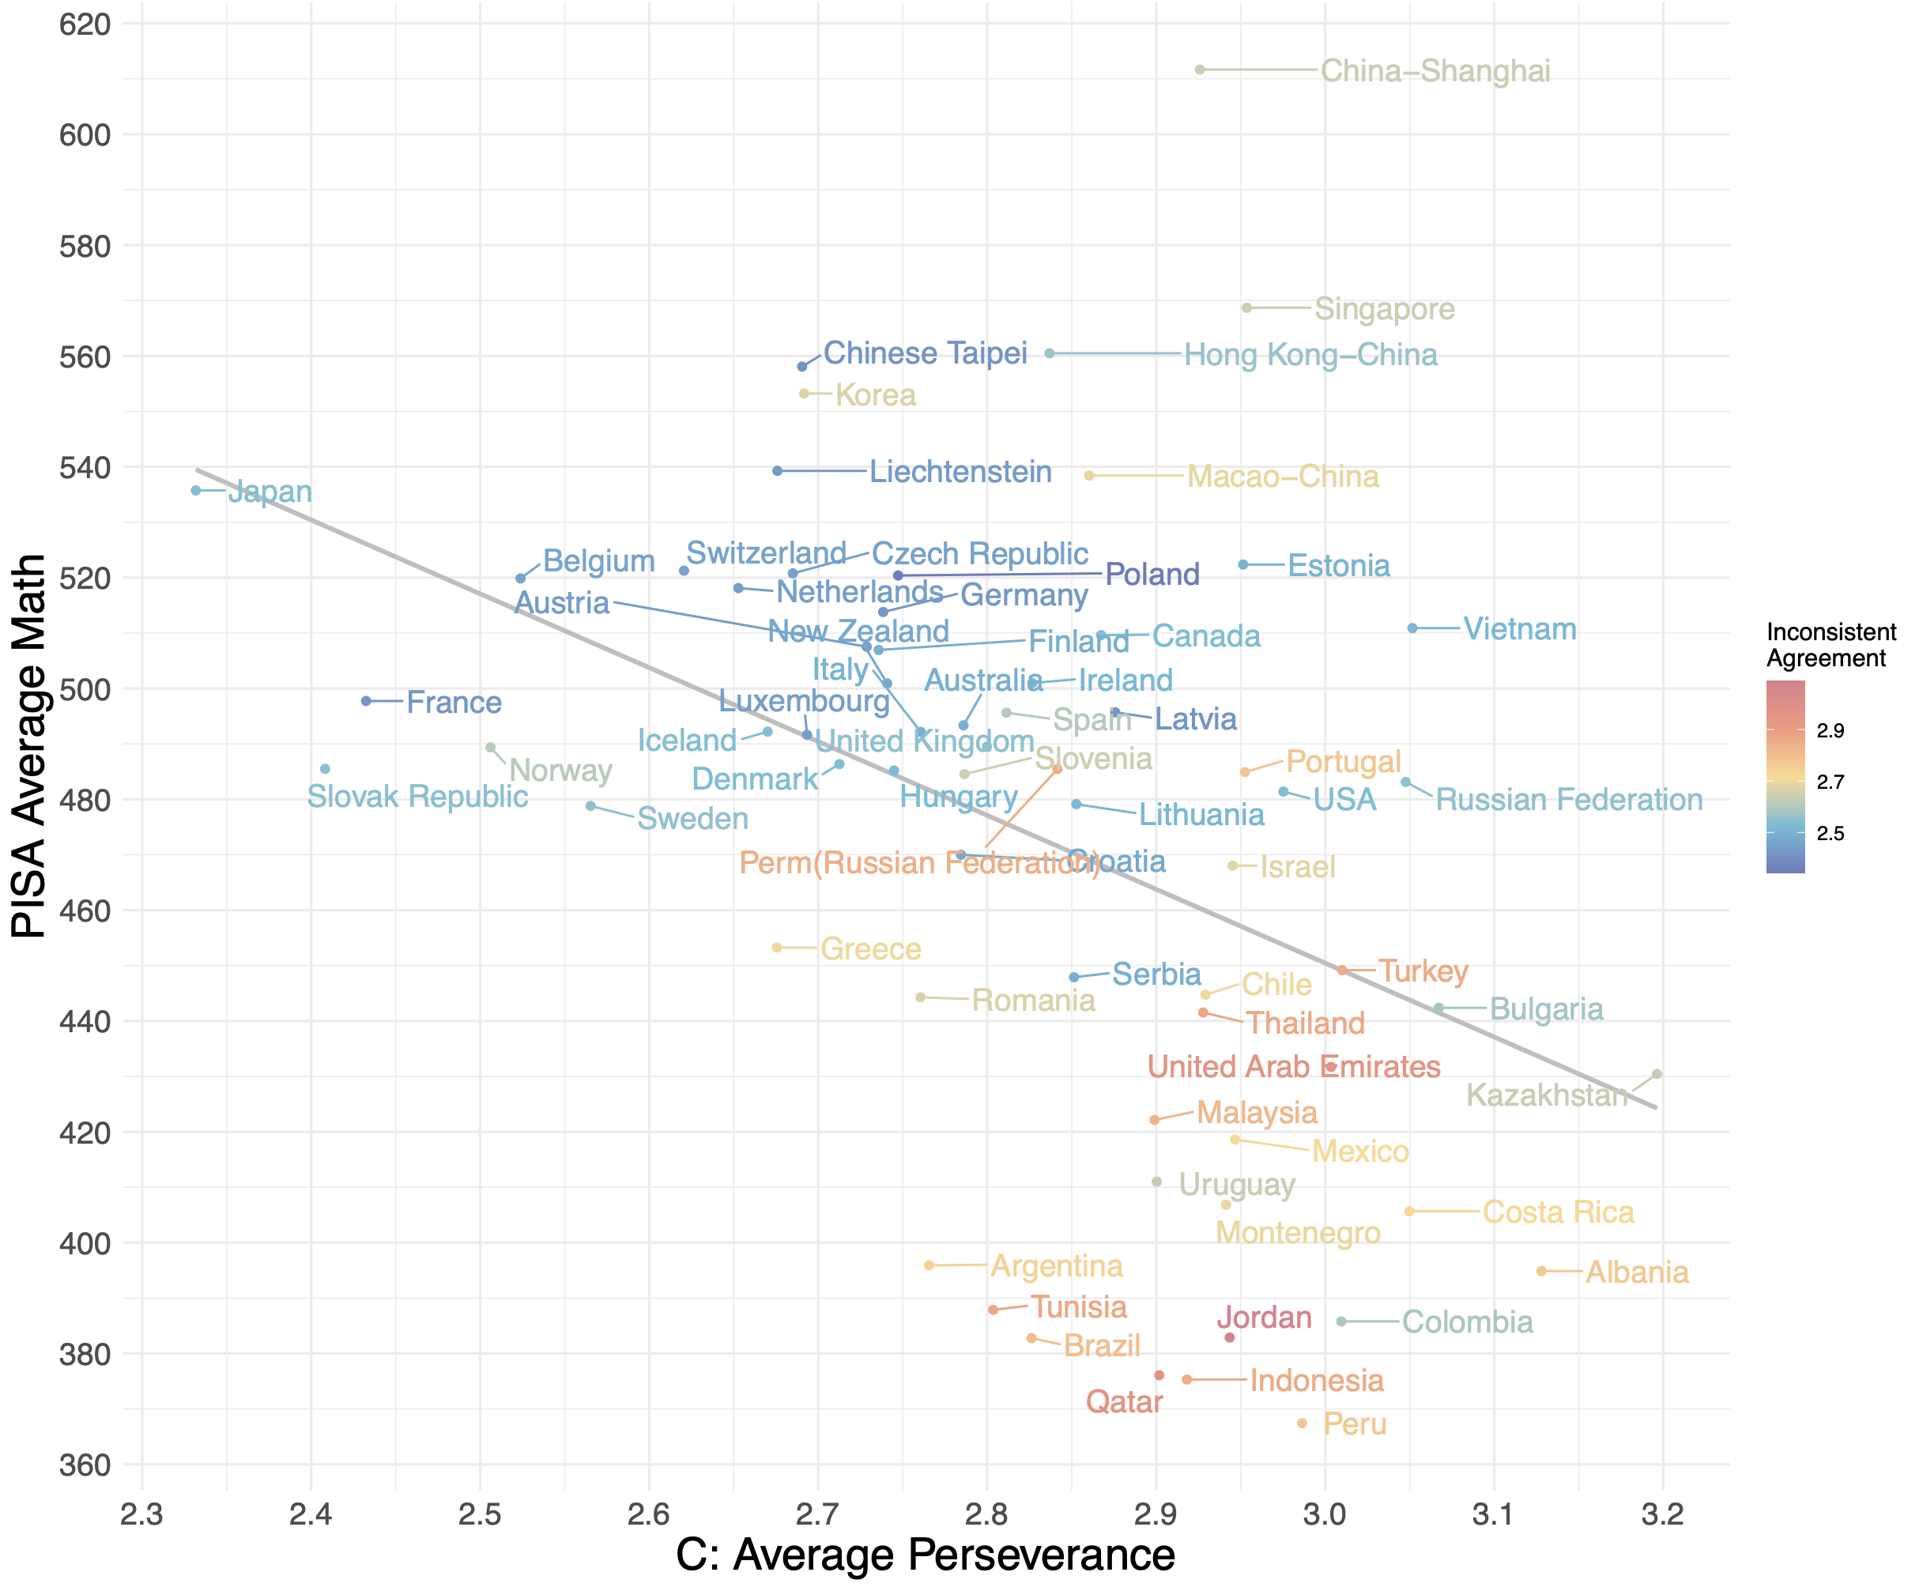
Revisiting aptitude achievement paradox
Notes:
Coloring each country by average inconsistency.
Rescoring method is a simple: we recalculate perseverance at the level of the individual subtracting their inconsistency index. It is a deviation score around inconsistency.
If I do that and average these scores

Slide 53
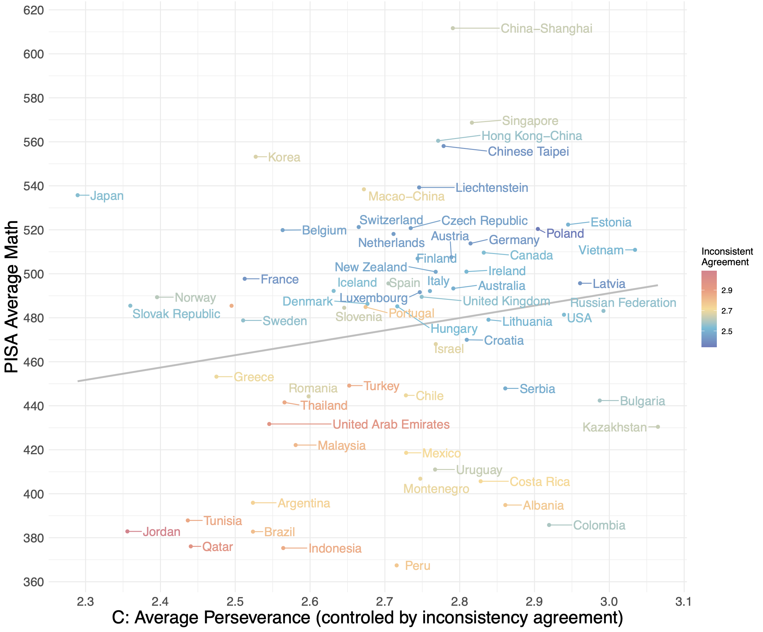
Solving part of the aptitude achievement paradox
Notes:
12 out of 17 scales showed paradoxical correlations, after the method we proposed
8 flipped from negative to positive, and 4 that were already positive increased!
Explanation of the Simpson’s Paradox in this case: Inconsistency is a suppressor confounder at the country level. It is negatively related to achievement and positively related to social and emotional skills. The magnitude of this positive relationship depends upon the ratio of the positive pole items to negative pole items comprising the scale

Slide 55
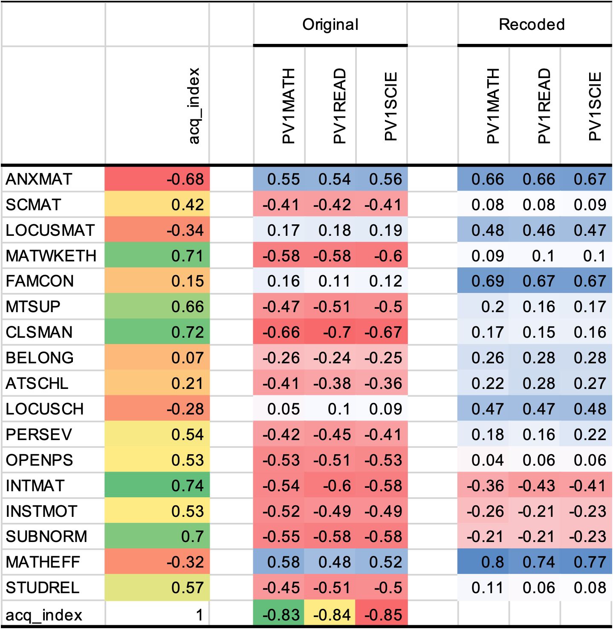
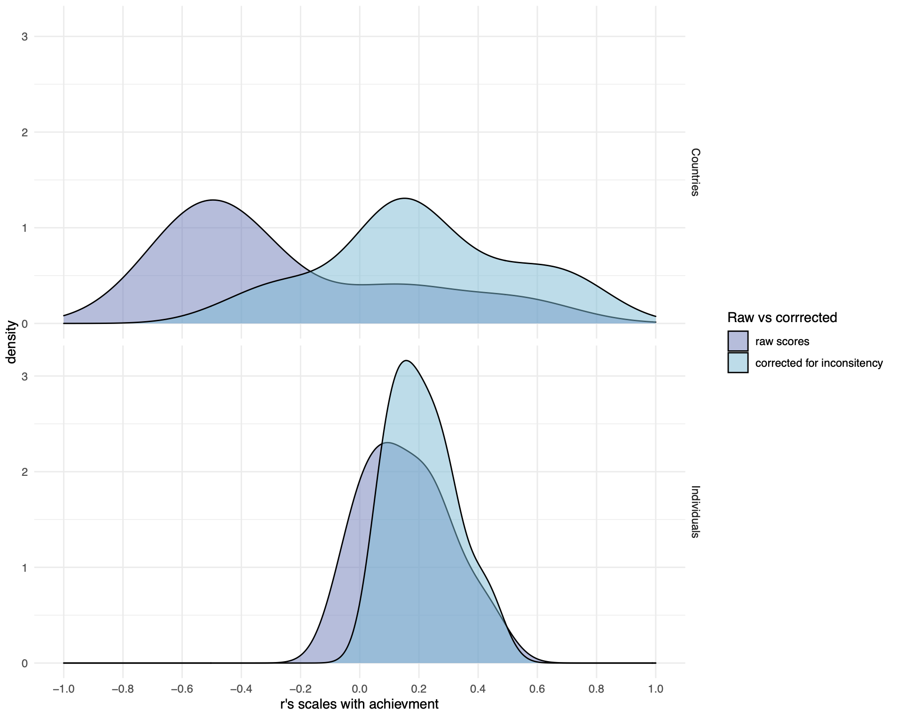

Slide 56
Conclusions
ACQ impacts validity in several levels
Counfounders: motivation, cognitive skills
Importance of good negative pole items
Beyond measuring socio-emotional skills, it is imperative to assess response styles, specifically how participants react to scales, in order to utilize this data for mitigating systematic measurement errors.

Slide 57
References
Bertling, J., & Alegre, J. (2019). PISA 2021 Context Questionnaire Framework (Field Trial Version). Educational Testing Services. https://www.oecd.org/pisa/sitedocument/PISA-2021-questionnaire-framework.pdf
Kyllonen, P. C., & Bertling, J. P. (2013). Innovative Questionnaire Assessment Methods to Increase Cross Country Comparability. In Handbook of International Large-Scale Assessment (Vol. 1–0, pp. 277–285). Chapman and Hall/CRC. https://doi.org/10.1201/b16061-15
Olderbak, S., & Wilhelm, O. (2020). Overarching Principles for the Organization of Socioemotional Constructs. Current Directions in Psychological Science, 29(1), 63–70. https://doi.org/10.1177/0963721419884317
Pearl, J., Glymour, M., & Jewell, N. P. (2016). Causal Inference in Statistics: A Primer (1a edição). Wiley.
Poropat, A. E. (2009). A meta-analysis of the five-factor model of personality and academic performance. Psychological Bulletin, 135(2), 322–338. https://doi.org/10.1037/a0014996
Santos, D., & Primi, R. (2014). Social and Emotional Development and School Learning: A Measurement Proposal in Support of Public Policy. São Paulo: EduLab21, Instituto Ayrton Senna. Available online at: https://globaled.gse.harvard.edu/files/geii/files/social-and-emotional-developmente-and-school-learning1.pdf (accessed November 23, 2016).

Slide 58
https://github.com/rprimi/acqu_mirt

Slide 59
Old wisdom
“since response tendencies affect an answer only when the student is to some degree uncertain about the content of the item, acquiescence tends to make false items, more valid, and true items less valid … The poor student, guessing, tends to be right on the true item because of acquiescence, but tends to be wrong on the false item.” (Cronbach, 1946 p. 480)

